Slide 1
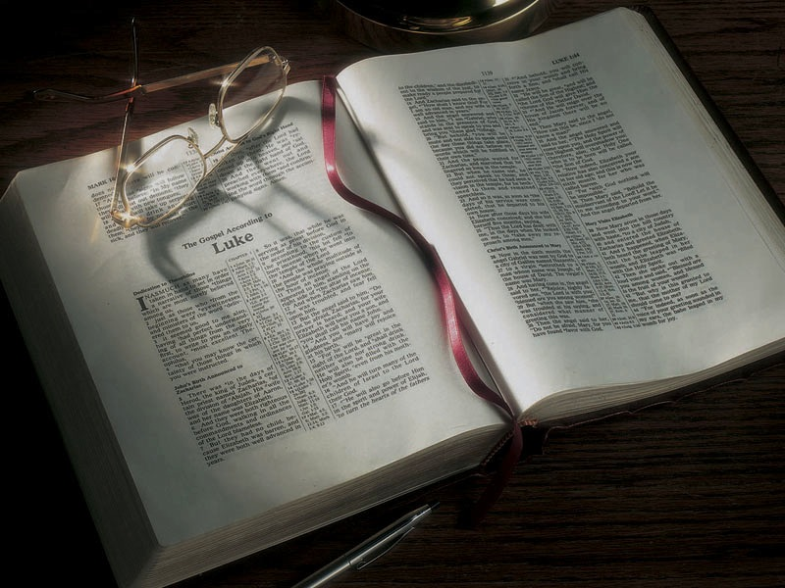

Slide 2
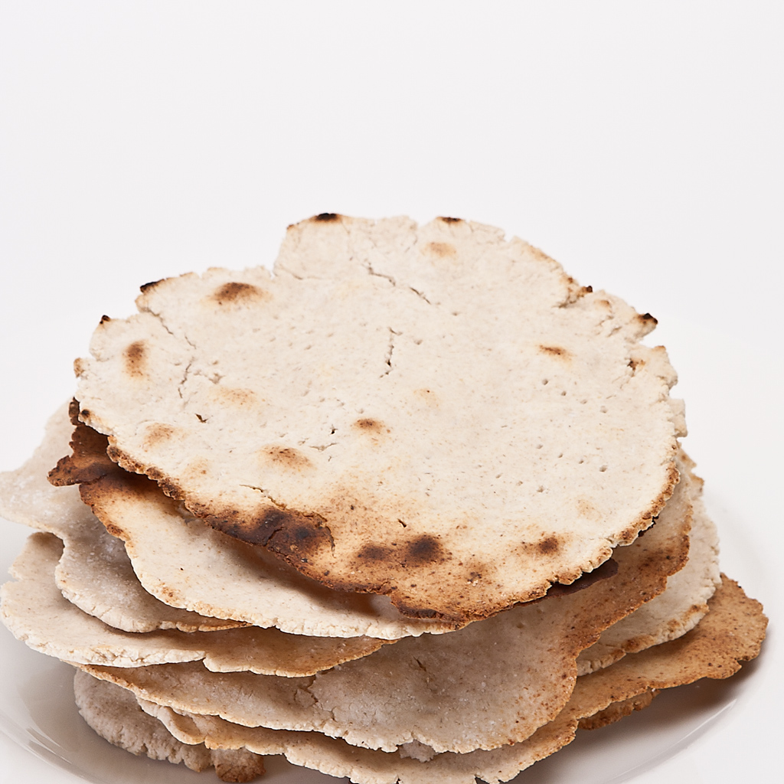

Slide 3
Exodus 12:17-20
17 So you shall observe the Feast of Unleavened Bread . . .
18 In the first month, on the fourteenth day of the month at evening, you shall eat unleavened bread, until the twenty-first day of the month at evening . . .
20 You shall eat nothing leavened; in all your dwellings you shall eat unleavened bread.

Slide 4
Exodus 13:6-7
6 Seven days you shall eat unleavened bread, and on the seventh day there shall be a feast to the LORD.
7 Unleavened bread shall be eaten seven days. And no leavened bread shall be seen among you, nor shall leaven be seen among you in all your quarters.

Slide 5
Exodus 13:6-7
6 Seven days you shall eat unleavened bread, and on the seventh day there shall be a feast to the LORD.
7 Unleavened bread shall be eaten seven days. And no leavened bread shall be seen among you, nor shall leaven be seen among you in all your quarters.
Exodus 34:18
18 “The Feast of Unleavened Bread you shall keep. Seven days you shall eat unleavened bread, as I commanded you . . .

Slide 6
Leviticus 23:6
6 And on the fifteenth day of the same month is the Feast of Unleavened Bread to the LORD; seven days you must eat unleavened bread.

Slide 7
Leviticus 23:6
6 And on the fifteenth day of the same month is the Feast of Unleavened Bread to the LORD; seven days you must eat unleavened bread.
Numbers 28:17
17 And on the fifteenth day of this month is the feast; unleavened bread shall be eaten for seven days.

Slide 8
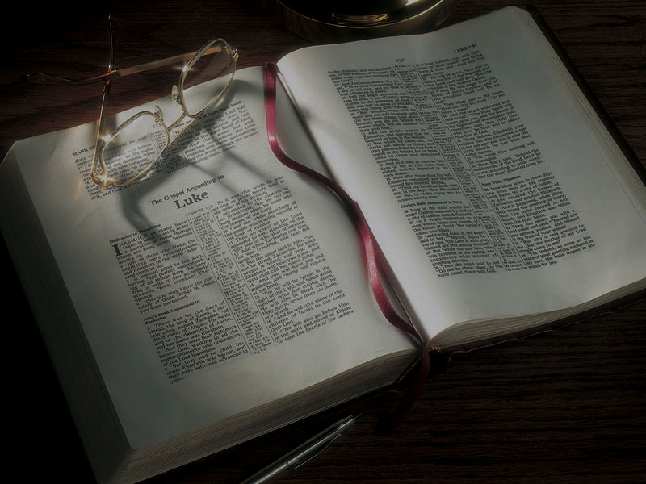
Are You Eating
the Unleavened Bread of Life?

Slide 9
1 Corinthians 5:6-8
6 Your glorying is not good. Do you not know that a little leaven leavens the whole lump?
7 Therefore purge out the old leaven, that you may be a new lump, since you truly are unleavened. For indeed Christ, our Passover, was sacrificed for us.
8 Therefore let us keep the feast, not with old leaven, nor with the leaven of malice and wickedness, but with the unleavened bread of sincerity and truth.

Slide 10
John 6:1-58
1 After these things Jesus went over the Sea of Galilee, which is the Sea of Tiberias.
2 Then a great multitude followed Him, because they saw His signs which He performed on those who were diseased.
3 And Jesus went up on the mountain, and there He sat with His disciples.
4 Now the Passover, a feast of the Jews, was near.

Slide 11
John 6:1-58
5 Then Jesus lifted up His eyes, and seeing a great multitude coming toward Him, He said to Philip, “Where shall we buy bread, that these may eat?”
6 But this He said to test him, for He Himself knew what He would do.
7 Philip answered Him, “Two hundred denarii worth of bread is not sufficient for them, that every one of them may have a little.”

Slide 12
John 6:1-58
8 One of His disciples, Andrew, Simon Peter’s brother, said to Him,
9 “There is a lad here who has five barley loaves and two small fish, but what are they among so many?”
10 Then Jesus said, “Make the people sit down.” Now there was much grass in the place. So the men sat down, in number about five thousand.

Slide 13
John 6:1-58
11 And Jesus took the loaves, and when He had given thanks He distributed them to the disciples, and the disciples to those sitting down; and likewise of the fish, as much as they wanted.
12 So when they were filled, He said to His disciples, “Gather up the fragments that remain, so that nothing is lost.”
13 Therefore they gathered them up, and filled twelve baskets with the fragments of the five barley loaves which were left over by those who had eaten.

Slide 14
John 6:1-58
22 On the following day, when the people who were standing on the other side of the sea saw that there was no other boat there, except that one which His disciples had entered, and that Jesus had not entered the boat with His disciples, but His disciples had gone away alone—
23 however, other boats came from Tiberias, near the place where they ate bread after the Lord had given thanks—

Slide 15
John 6:1-58
24 when the people therefore saw that Jesus was not there, nor His disciples, they also got into boats and came to Capernaum, seeking Jesus.
25 And when they found Him on the other side of the sea, they said to Him, “Rabbi, when did You come here?”
26 Jesus answered them and said, “Most assuredly, I say to you, you seek Me, not because you saw the signs, but because you ate of the loaves and were filled.

Slide 16
John 6:1-58
27 “Do not labor for the food which perishes, but for the food which endures to everlasting life, which the Son of Man will give you, because God the Father has set His seal on Him.”
28 Then they said to Him, “What shall we do, that we may work the works of God?”
29 Jesus answered and said to them, “This is the work of God, that you believe in Him whom He sent.”

Slide 17
John 6:1-58
30 Therefore they said to Him, “What sign will You perform then, that we may see it and believe You? What work will You do?
31 “Our fathers ate the manna in the desert; as it is written, ‘He gave them bread from heaven to eat.’”
32 Then Jesus said to them, “Most assuredly, I say to you, Moses did not give you the bread from heaven, but My Father gives you the true bread from heaven.

Slide 18
John 6:1-58
33 “For the bread of God is He who comes down from heaven and gives life to the world.”
34 Then they said to Him, “Lord, give us this bread always.”
35 And Jesus said to them, “I am the bread of life. He who comes to Me shall never hunger, and he who believes in Me shall never thirst.

Slide 19
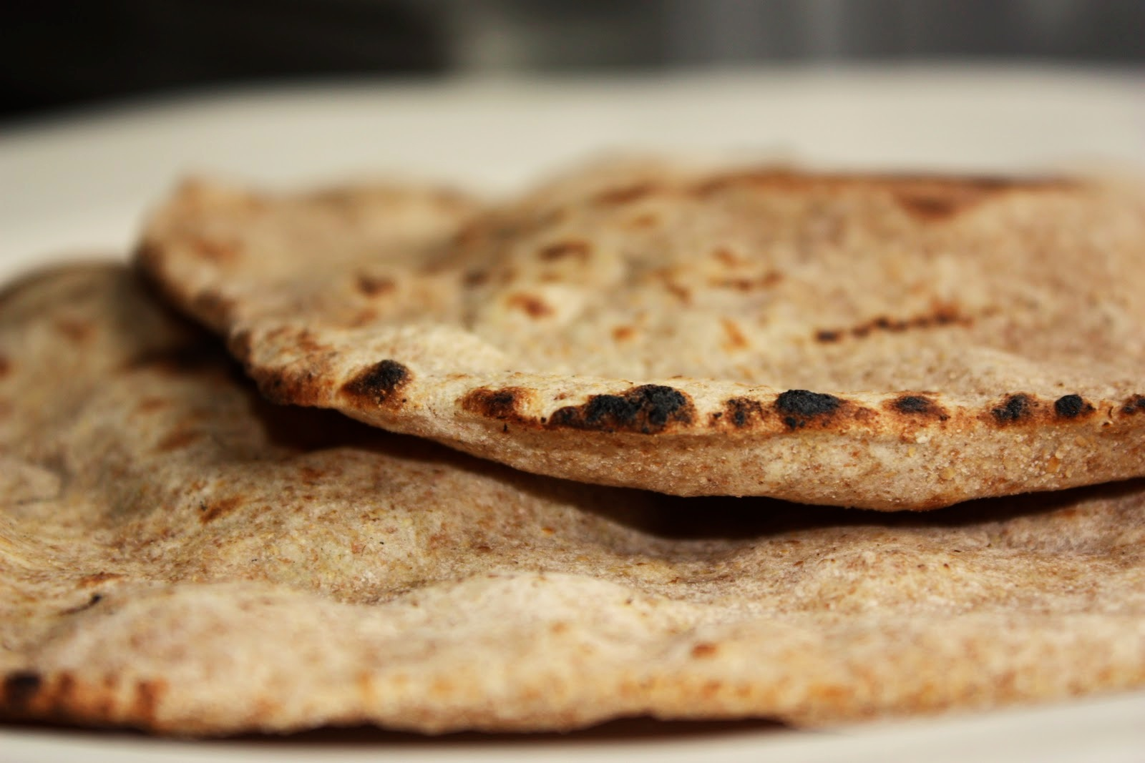

Slide 20
John 6:1-58
47 “Most assuredly, I say to you, he who believes in Me has everlasting life.
48 “I am the bread of life.
49 “Your fathers ate the manna in the wilderness, and are dead.
50 “This is the bread which comes down from heaven, that one may eat of it and not die.
51 “I am the living bread which came down from heaven. If anyone eats of this bread, he will live forever; and the bread that I shall give is My flesh, which I shall give for the life of the world.”

Slide 21
John 6:1-58
52 The Jews therefore quarreled among themselves, saying, “How can this Man give us His flesh to eat?”
53 Then Jesus said to them, “Most assuredly, I say to you, unless you eat the flesh of the Son of Man and drink His blood, you have no life in you.
54 “Whoever eats My flesh and drinks My blood has eternal life, and I will raise him up at the last day.

Slide 22
John 6:1-58
55 “For My flesh is food indeed, and My blood is drink indeed.
56 “He who eats My flesh and drinks My blood abides in Me, and I in him.
57 “As the living Father sent Me, and I live because of the Father, so he who feeds on Me will live because of Me.
58 “This is the bread which came down from heaven—not as your fathers ate the manna, and are dead. He who eats this bread will live forever.”

Slide 23
Four main types of sacrifices:
1. Grain or meal offering: part burned (given to God), the rest given to priests.
2. Sin or guilt offering: part burned, the rest given to priests.
3. Burnt offering: burned completely.
4. Peace or fellowship offering: part burned, the rest eaten by the worshiper and guests as a meal.

Slide 24
Leviticus 17:10-11
10 . . . I will set My face against that person who eats blood . . .
11 For the life of the flesh is in the blood . . .

Slide 25
Leviticus 17:10-11
10 . . . I will set My face against that person who eats blood . . .
11 For the life of the flesh is in the blood . . .
Genesis 9:4
4 But you shall not eat flesh with its life, that is, its blood.

Slide 26
Deuteronomy 12:23
23 Be sure that you do not eat the blood, for the blood is the life.

Slide 27
Deuteronomy 12:23
23 Be sure that you do not eat the blood, for the blood is the life.
Leviticus 17:14
14 You shall not eat the blood of any flesh, for the life of all flesh is its blood.

Slide 28
John 6:1-58
53 Then Jesus said to them, “Most assuredly, I say to you, unless you eat the flesh of the Son of Man and drink His blood, you have no life in you.
54 “Whoever eats My flesh and drinks My blood has eternal life, and I will raise him up at the last day.
55 “For My flesh is food indeed, and My blood is drink indeed.
56 “He who eats My flesh and drinks My blood abides in Me, and I in him.

Slide 29
John 6:1-58
57 “As the living Father sent Me, and I live because of the Father, so he who feeds on Me will live because of Me.
58 “This is the bread which came down from heaven—not as your fathers ate the manna, and are dead. He who eats this bread will live forever.”

Slide 30
Galatians 2:20
20 “I have been crucified with Christ; it is no longer I who live, but Christ lives in me; and the life which I now live in the flesh I live by faith in the Son of God, who loved me and gave Himself for me.

Slide 31
How do we partake of the true Bread of Life?

Slide 32
How do we partake of the true Bread of Life?
1. Realize that just as you need physical bread or food to sustain your physical life, you need the unleavened Bread of Life, Jesus Christ, to nourish you spiritually.

Slide 33
How do we partake of the true Bread of Life?
1. Realize that just as you need physical bread or food to sustain your physical life, you need the unleavened Bread of Life, Jesus Christ, to nourish you spiritually. John 6, which we’ve covered today, explains this.

Slide 34
How do we partake of the true Bread of Life?
2. Learn about Him!

Slide 35
How do we partake of the true Bread of Life?
2. Learn about Him! How much time do you spend with Him?

Slide 36
How do we partake of the true Bread of Life?
2. Learn about Him! How much time do you spend with Him?
Are you a follower or a pretender?

Slide 37
How do we partake of the true Bread of Life?
3. Study His teachings.

Slide 38
How do we partake of the true Bread of Life?
3. Study His teachings.
Matthew 4:4
4 Man shall not live by bread alone, but by every word that proceeds from the mouth of God.

Slide 39
How do we partake of the true Bread of Life?
4. Make His priorities your priorities.

Slide 40
How do we partake of the true Bread of Life?
4. Make His priorities your priorities.
John 4:34
34 Jesus said to them, “My food is to do the will of Him who sent Me, and to finish His work.

Slide 41
How do we partake of the true Bread of Life?
4. Make His priorities your priorities.
John 4:34
34 Jesus said to them, “My food is to do the will of Him who sent Me, and to finish His work.
John 6:38
38 For I have come down from heaven, not to do My own will, but the will of Him who sent Me.

Slide 42
How do we partake of the true Bread of Life?
5. Lay down your life for others as He laid down His life for you.

Slide 43
How do we partake of the true Bread of Life?
5. Lay down your life for others as He laid down His life for you.
John 15:13
13 Greater love has no one than this, than to lay down one’s life for his friends.

Slide 44
How do we partake of the true Bread of Life?
5. Lay down your life for others as He laid down His life for you.
John 15:13
13 Greater love has no one than this, than to lay down one’s life for his friends.
1 John 3:16
16 By this we know love, because He laid down His life for us. And we also ought to lay down our lives for the brethren.

Slide 45
Colossians 1:27
27 To them [the saints] God willed to make known what are the riches of the glory of this mystery among the Gentiles: which is Christ in you, the hope of glory.

